Slide 1
GESTURE - CONTROLLED SYSTEM OPERATIONS USING CNN
NAME : JOCELYN.A
REGISTER NO : 813821104052
DEPARTMENT : COMPUTER SCIENCE AND ENGINEERING

Slide 2
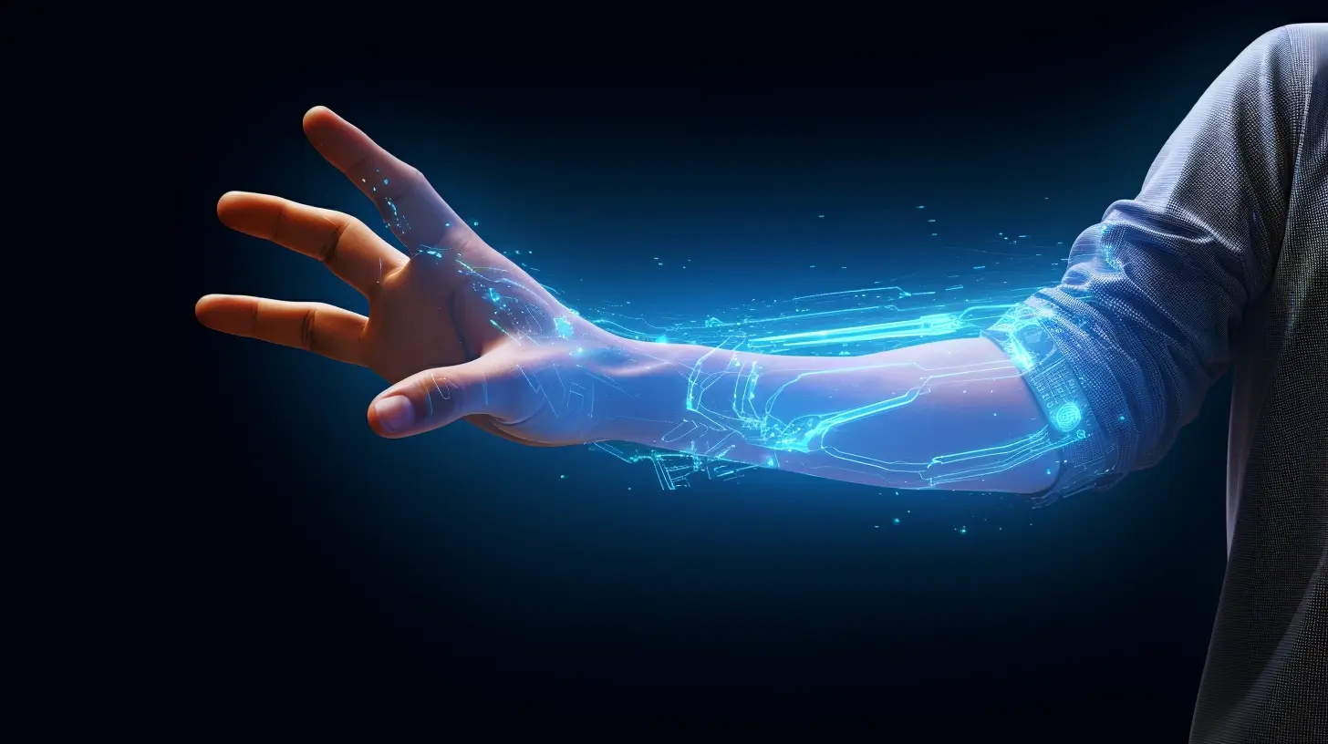
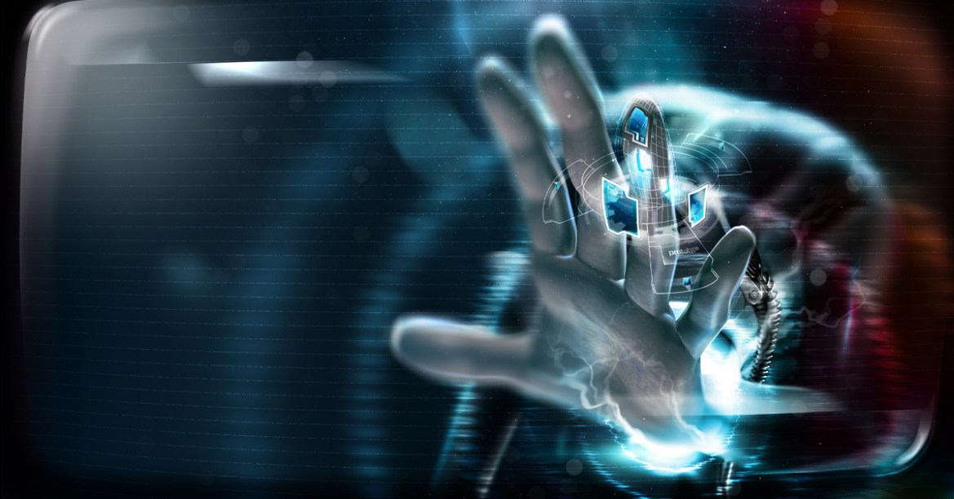
Gesture-Controlled System Operation
GESTURE - CONTROLLED SYSTEM OPERATIONS USING CNN

Slide 3


AGENDA
The agenda of this project is to create a gesture-controlled system that allows users to perform various operations using hand gestures, such as adjusting volume, closing tabs, and minimizing windows. Many more different hand gestures, which perform various kinds of operations, can also be incorporated into the system to expand its functionality and usability. The project aims to provide a hands-free and intuitive way of interacting with computer systems, enhancing user experience and accessibility.

Slide 4
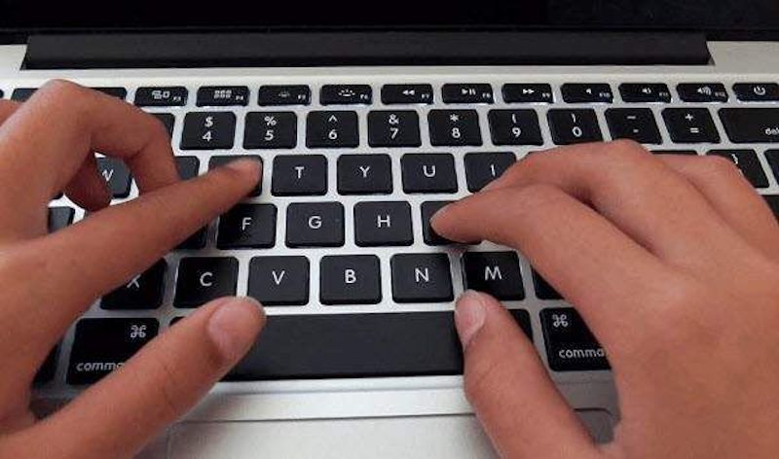

PROBLEM STATMENT
Traditional methods of interacting with computer systems, such as using a mouse or keyboard, may not always be convenient or accessible, especially in scenarios where users have limited mobility or are unable to use conventional input devices. There is a need for alternative interfaces that enable users to perform system operations effortlessly using gestures, without the need for physical input devices.

Slide 5
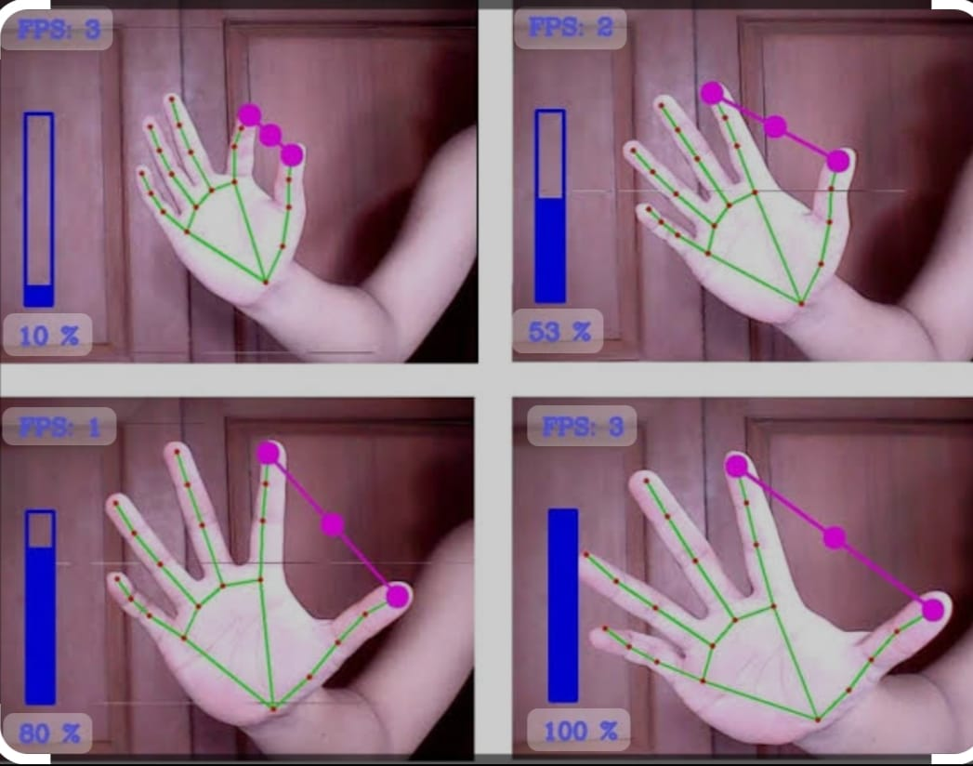
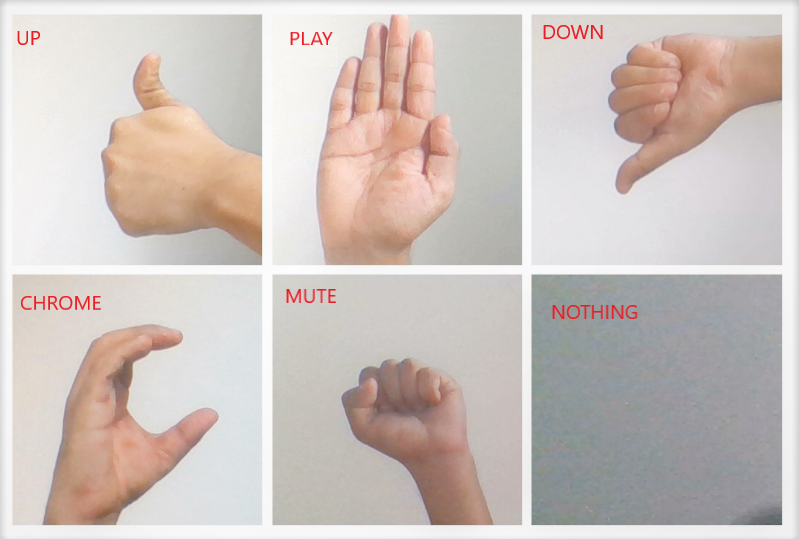
PROJECT OVERVIEW
The project involves developing a computer vision-based system that can recognize hand gestures captured through a webcam and map them to specific system operations. Using convolutional neural networks (CNN), the system will utilize machine learning algorithms to classify different hand gestures and trigger corresponding actions based on the recognized gestures.

Slide 6
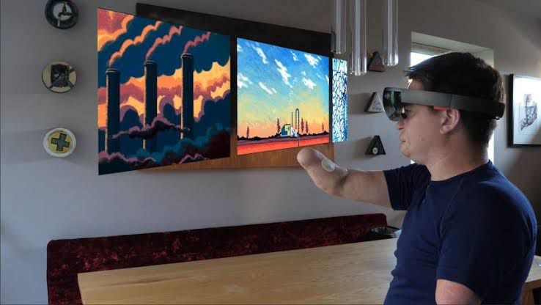
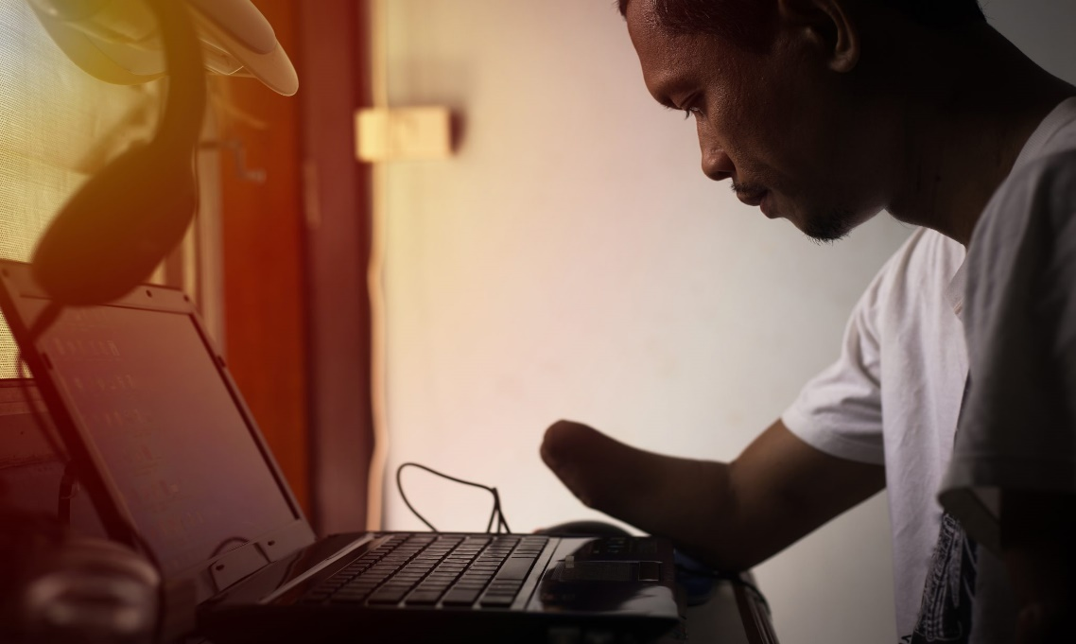

WHO ARE THE END USERS?
Individuals with physical disabilities or mobility impairments.
Users looking for a more intuitive and hands-free way of interacting with their computer systems.
Anyone interested in exploring novel interfaces for human-computer interaction.

Slide 7
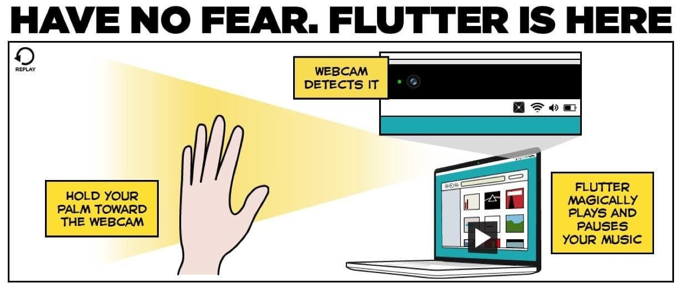
SOLUTION AND ITS VALUE PROPOSITION
The solution is a gesture-controlled system that provides a more natural and intuitive way of interacting with computer systems. By leveraging computer vision and machine learning techniques, users can perform various system operations simply by making predefined hand gestures, eliminating the need for physical input devices. The value proposition lies in improving accessibility, user experience, and productivity for individuals with disabilities or anyone seeking a more innovative way of interacting with technology.

Slide 8

THE WOW IN YOUR SOLUTION
The most captivating aspect of this project is the ability to control system operations seamlessly using hand gestures. Users can perform tasks such as adjusting volume, closing tabs, and minimizing windows with simple gestures, offering a futuristic and immersive computing experience.

Slide 9
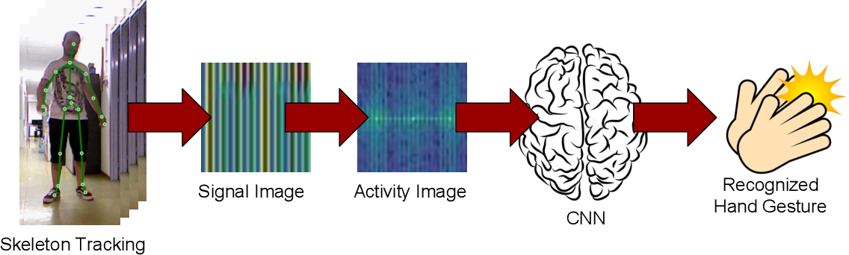
MODELLING
The project utilizes deep learning techniques, particularly convolutional neural networks (CNNs), for hand gesture recognition. The CNN model is trained on a dataset of hand gesture images representing different gestures such as thumbs up, thumbs down, fist symbol, peace symbol, etc.

Slide 10
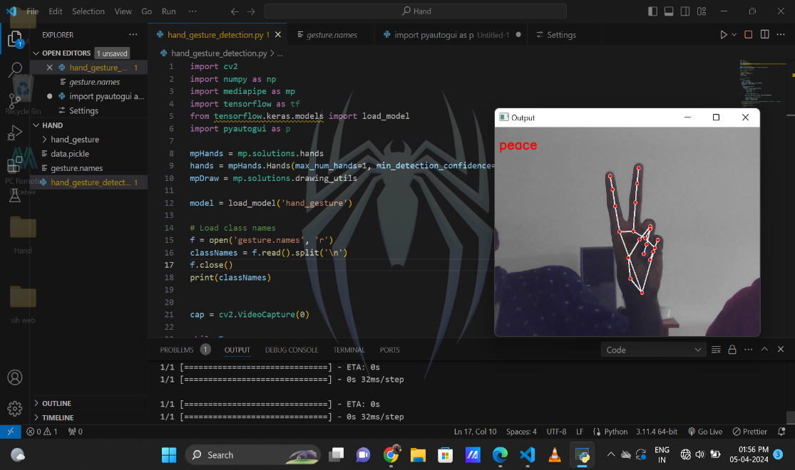
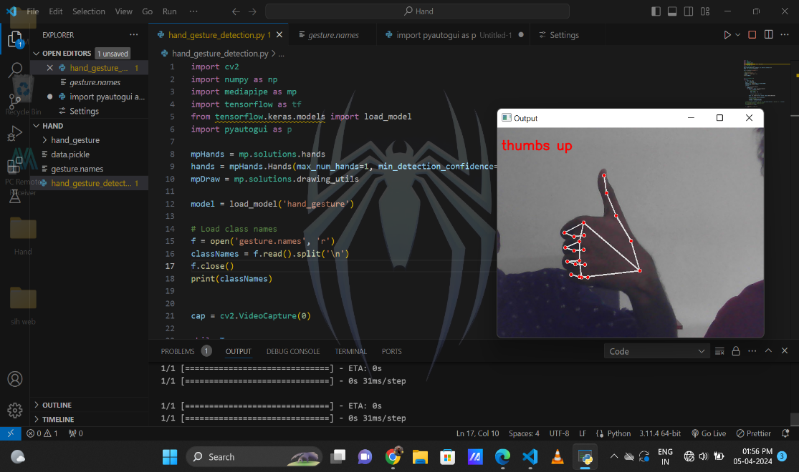
RESULTS
The trained model achieves high accuracy in recognizing hand gestures in real-time video streams captured from a webcam. Upon recognition of a gesture, the system accurately triggers the corresponding system operation, demonstrating the effectiveness and reliability of the gesture-controlled interface. By implementing this project, users can experience the seamless integration of gesture control into their computing environment, opening up new possibilities for interaction and accessibility.
The system will detect the given gesture and take action accordingly.

